Slide 1

Online Geography 140
Read the chapters
Watch animation or videos on U tube or in book. (specified in chapter summary guide)
Listen to this mini-lecture
Do activities
Take quiz
Study/summary guide
Each week
Study Guide
(Beachboard)
Mini-Lecture
(Beachboard)
Read Chapter and view multimedia
Assignments
5-15 pts
(Beachboard Or Mastering Geography)
Take quiz 10 pts
(Mastering Geogaphy)

Slide 2

Chapter 1
Latitude and Longitude
Seasons
Time zones

Slide 3
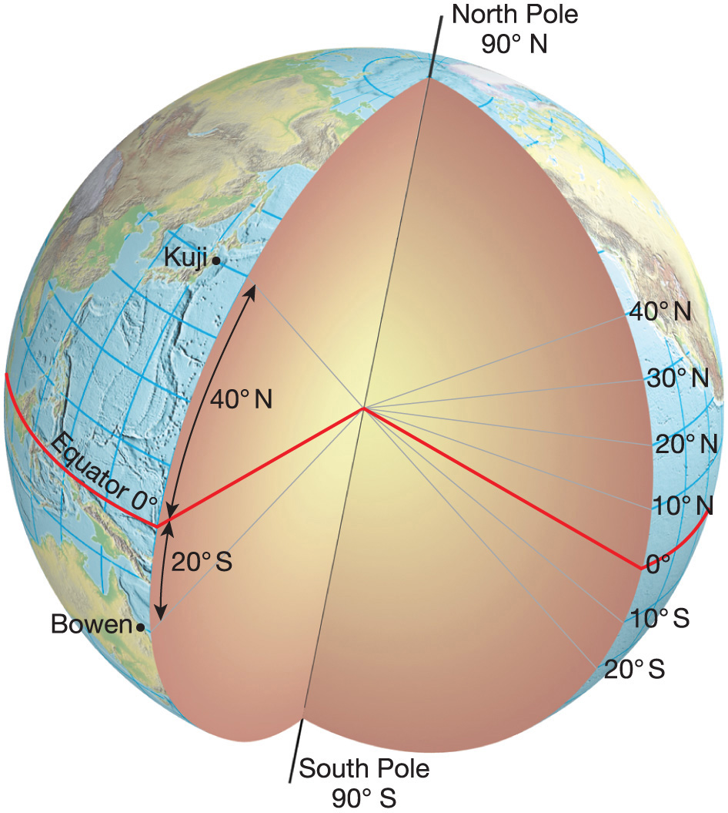

Notes:
Chapter 1, Figure 1.15 Labeled

Slide 4
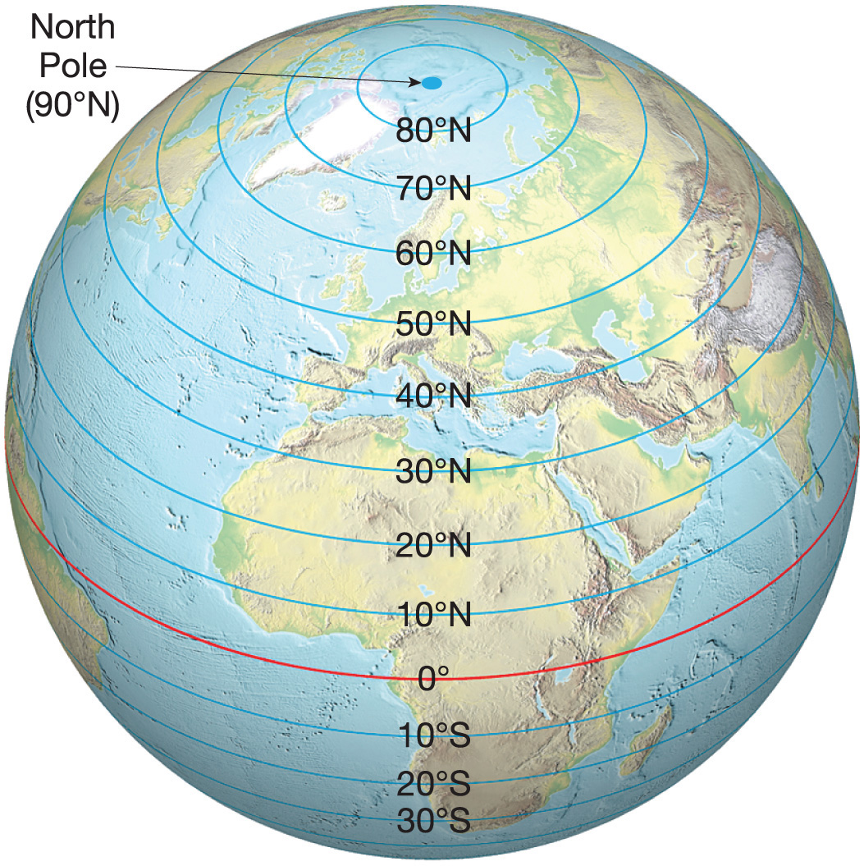

Notes:
Chapter 1, Figure 1.16 Labeled

Slide 5
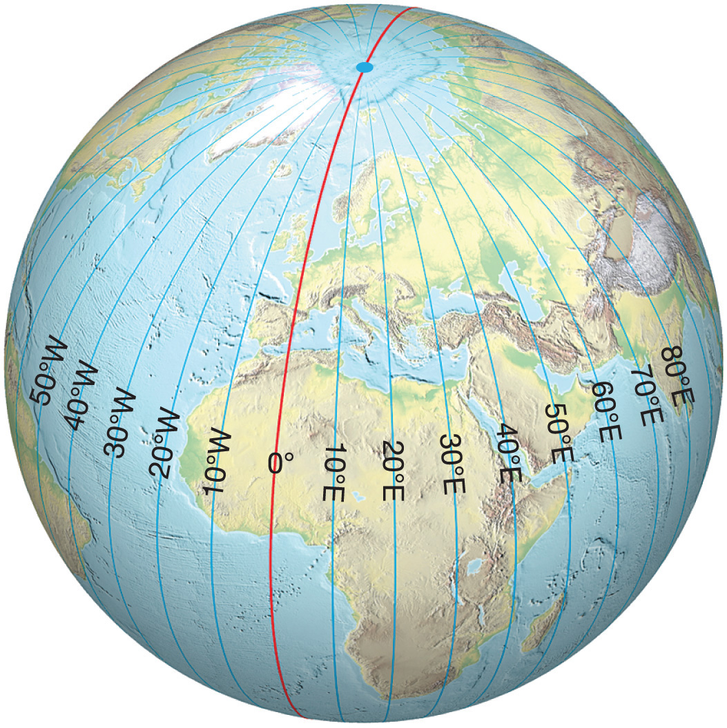

Notes:
Chapter 1, Figure 1.19 Labeled

Slide 6
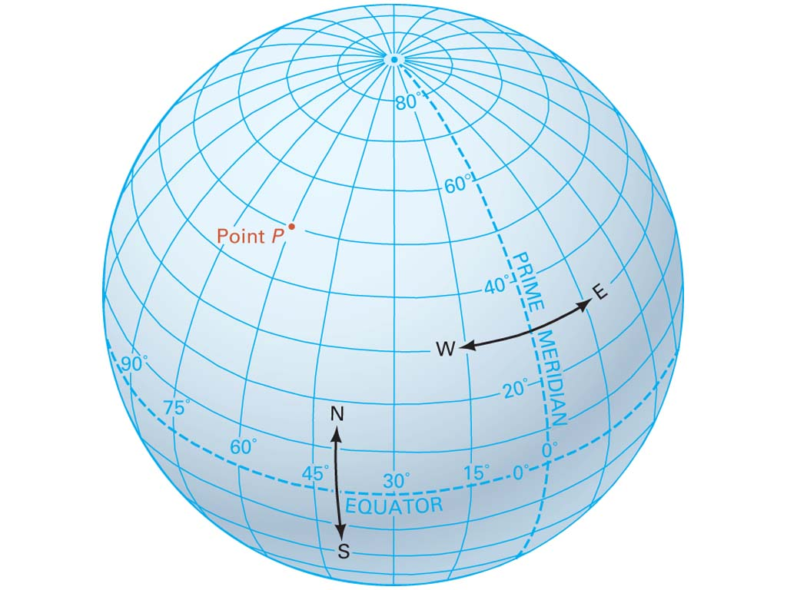

The Geographic Grid
http://www.youtube.com/watch?v=lUMlmRzkuuY

Slide 7
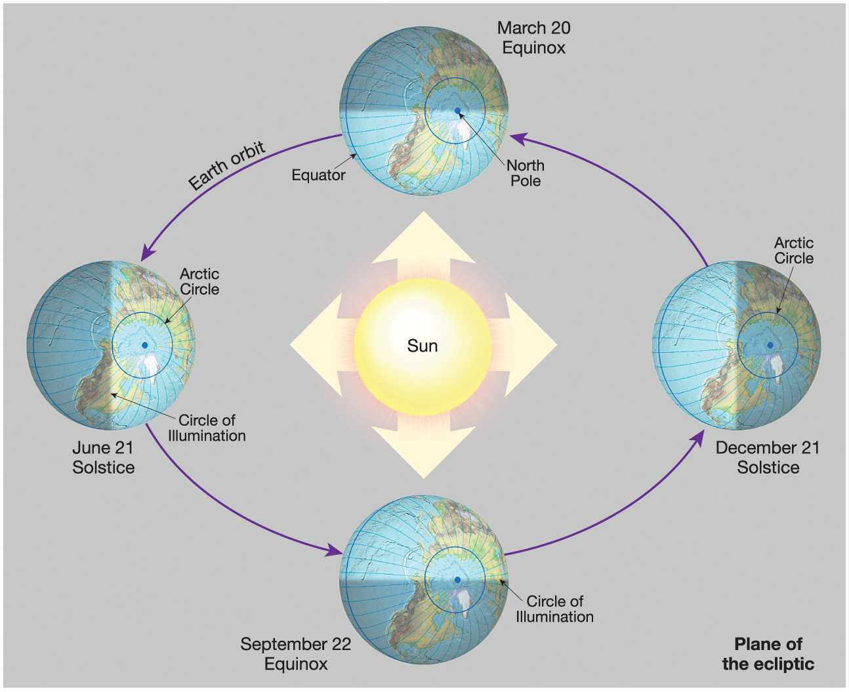

Circle of illumination: separates day hemisphere from night hemisphere
Notes:
–variation in day length and subsolar point.

Slide 8
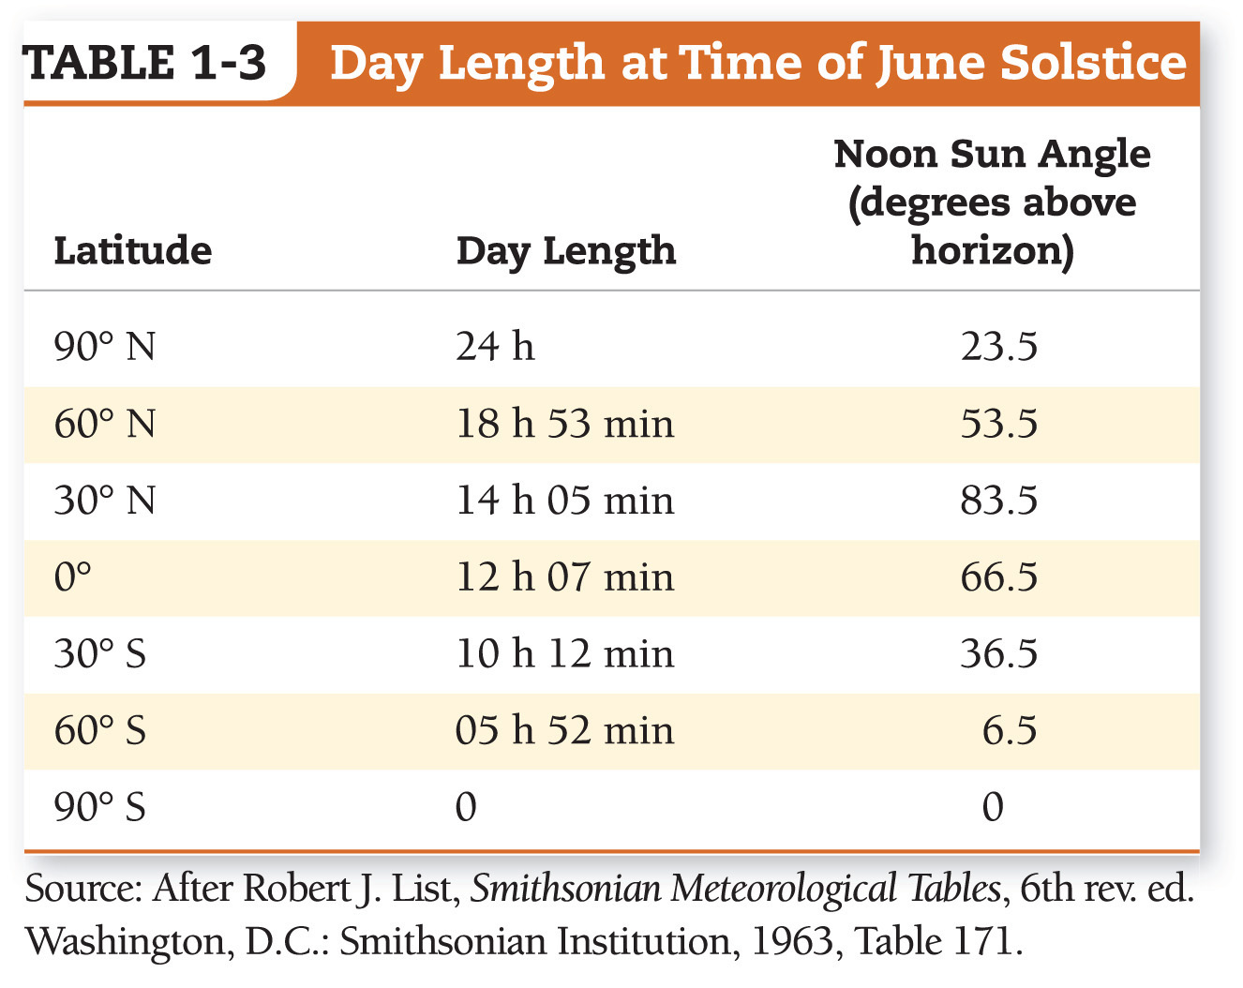

Notes:
Chapter 1, Table 1.3 Labeled

Slide 9
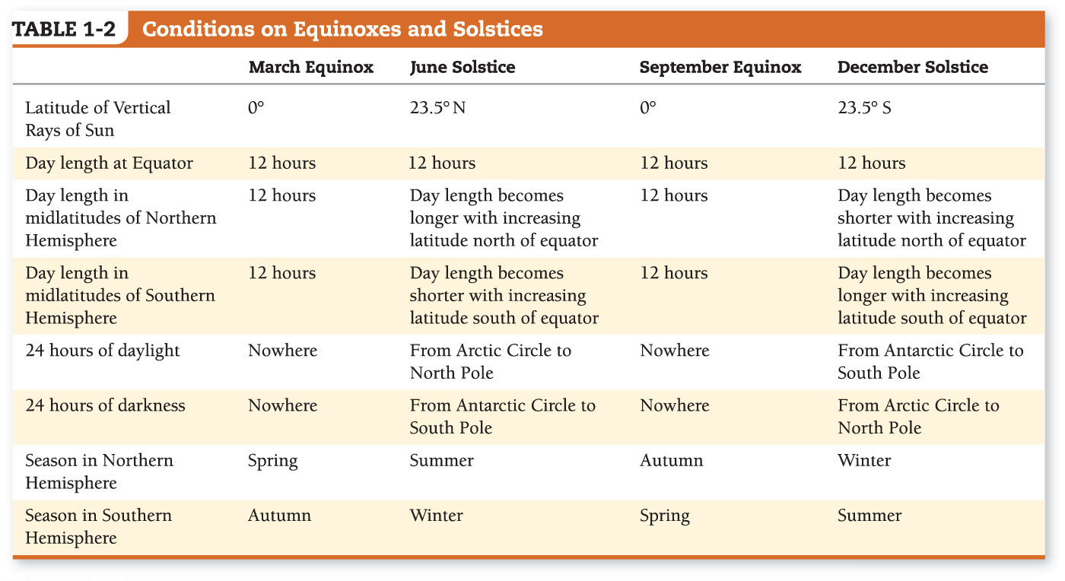


Notes:
(Northern Hemisphere)During our summer- days are longer. –This becomes more so as you go farther north. Reverse in Southern Hemisphere. At Equator 12 hours of daylight throughout the year.
Equinox 12 hours of daylight everywhere.

Slide 10
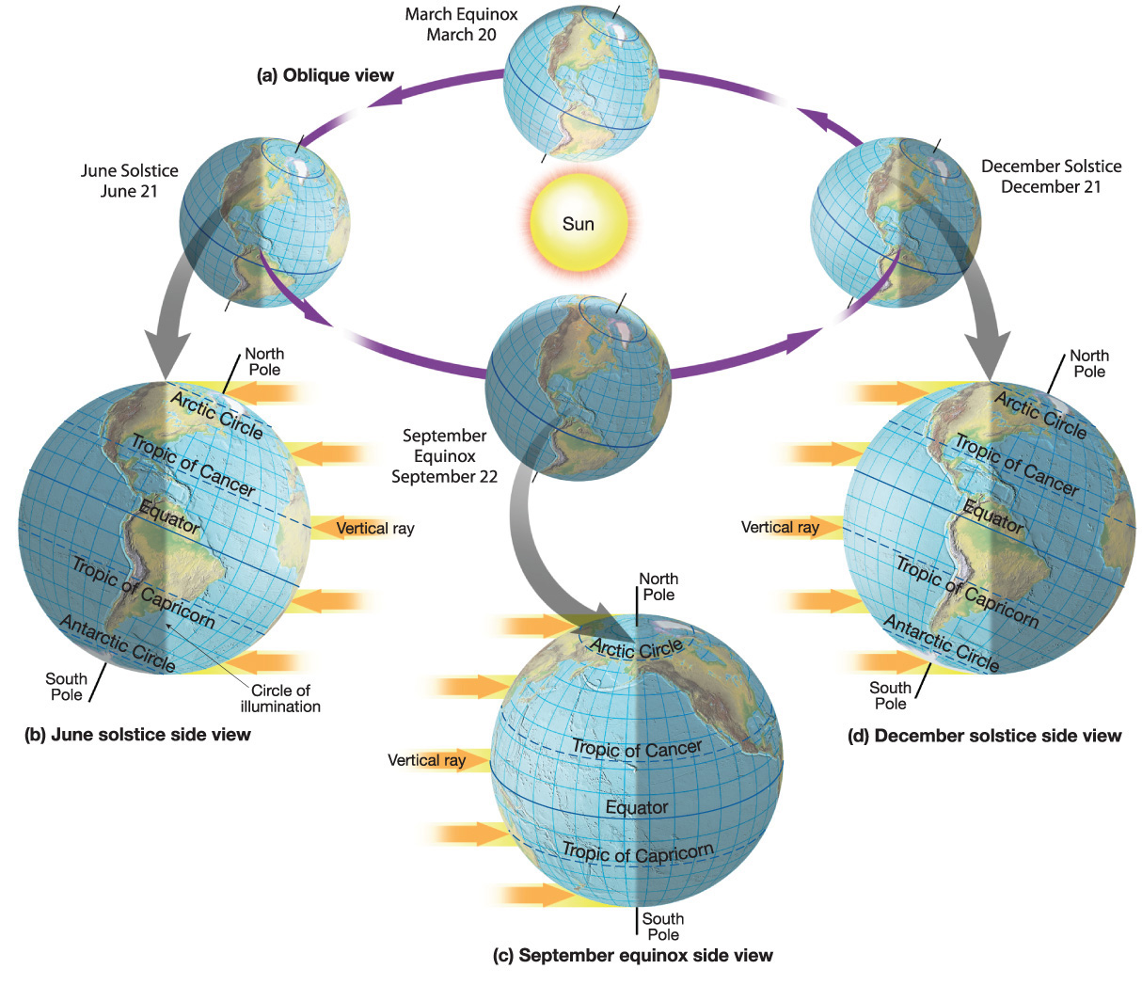

Notes:
Chapter 1, Figure 1.28 Labeled

Slide 11
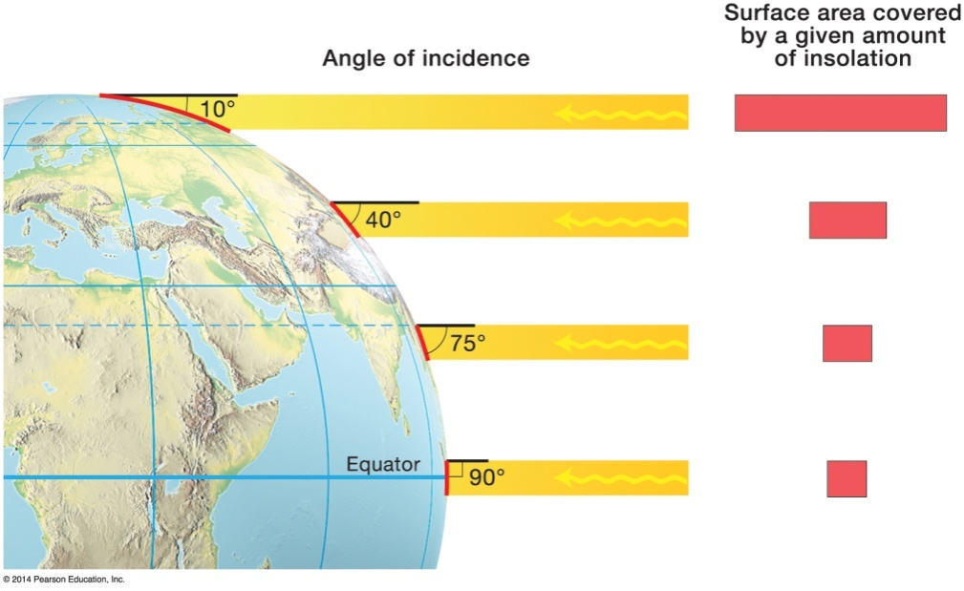
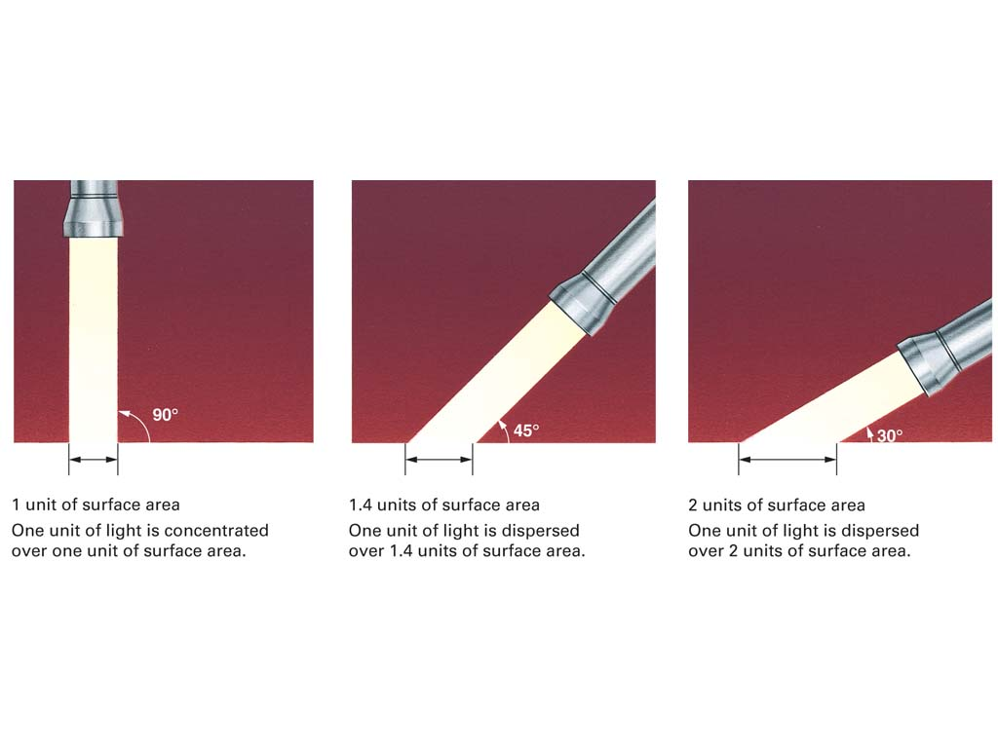

Variations in Insolation by Latitude and Season
Any one location on Earth’s surface can have its insolation modified by a variety of factors, including the following:
Angle of incidence
Atmospheric obstructions
Day length

Slide 12
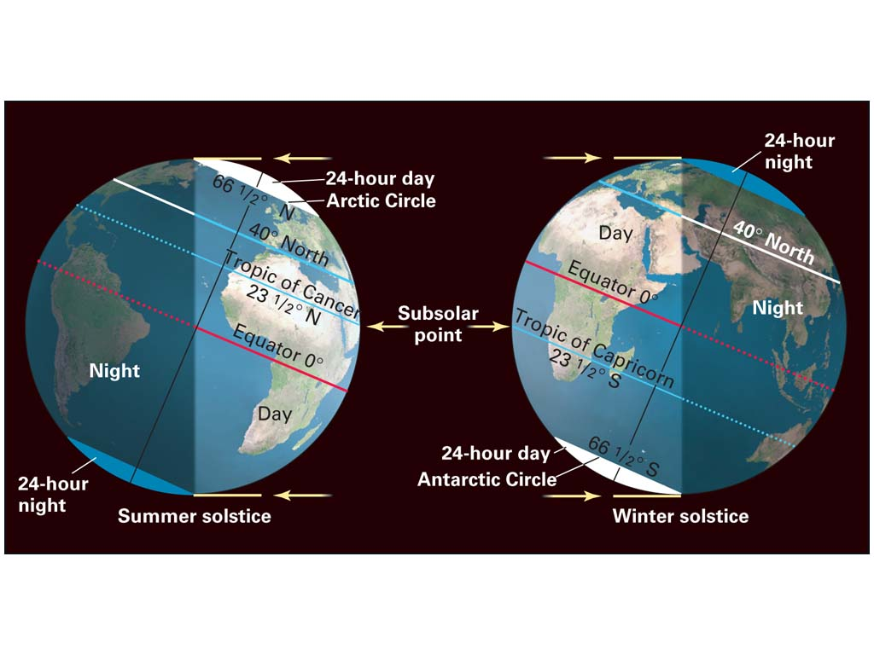

Subsolar Point

Slide 13
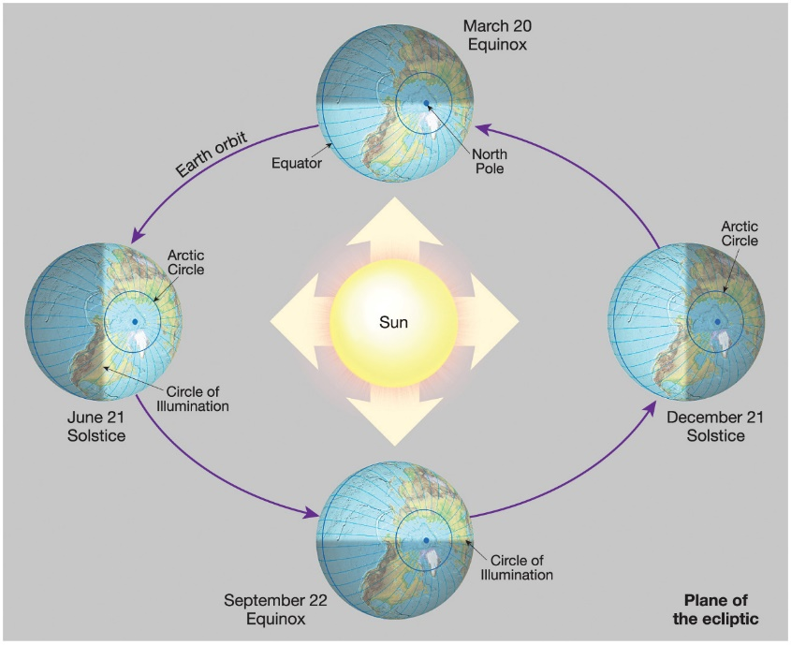


Seasons
Length of Day
Intensity of insolation (incoming solar radiation)

Slide 14
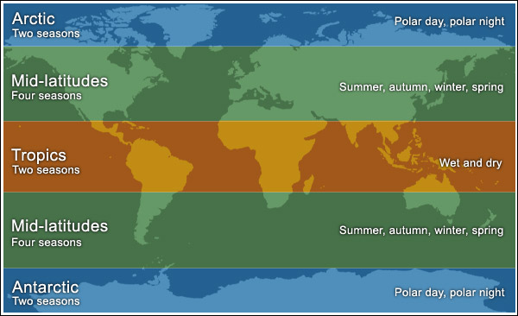

Earth–Sun Relations and the Seasons
Significance of seasonal patterns
24 hour day or night. Spread of solar rays over small and large areas.
Notes:
Extremes at artic and tropics. Midlatitude—where we are the angle changes throughout the year.

Slide 15
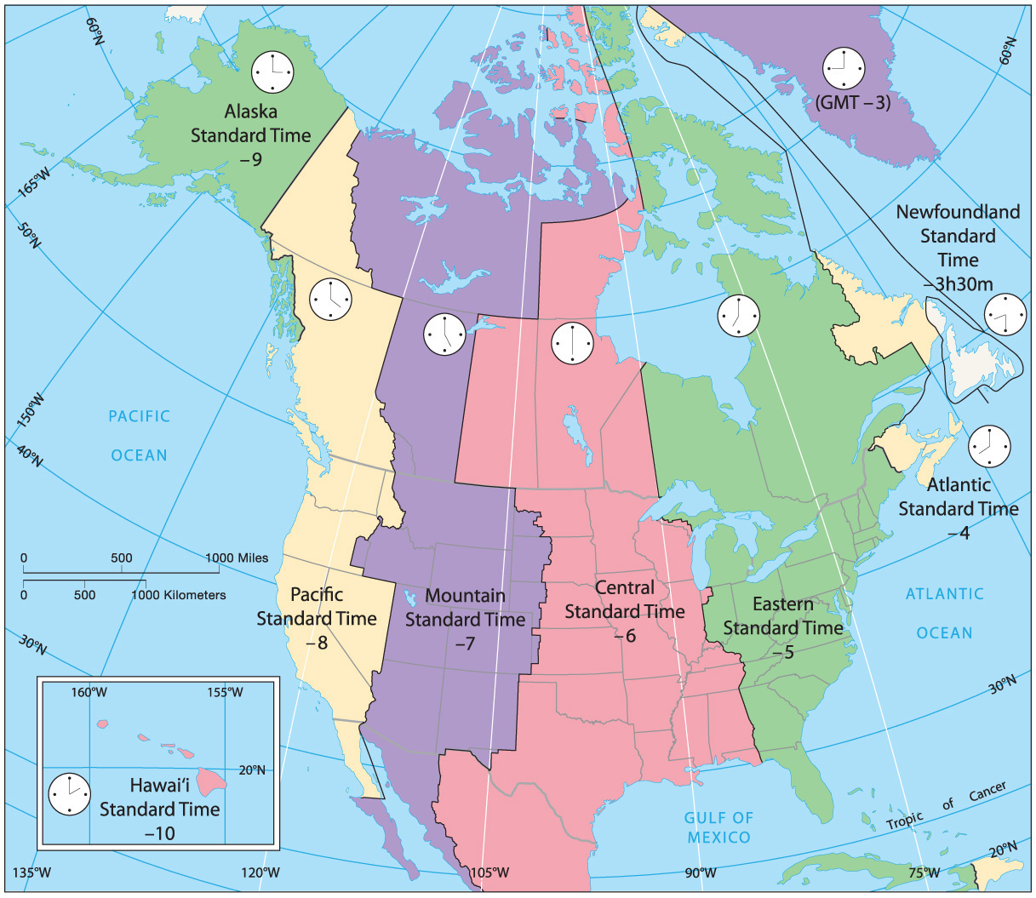

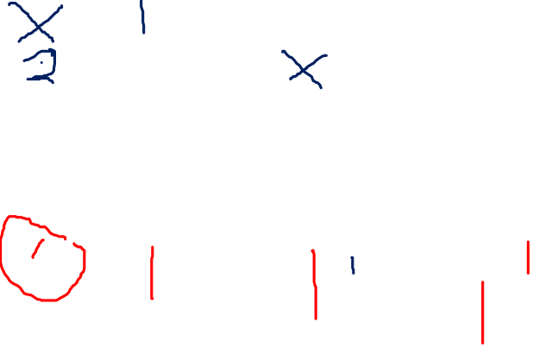
Notes:
Chapter 1, Figure 1.32 Labeled

Slide 16
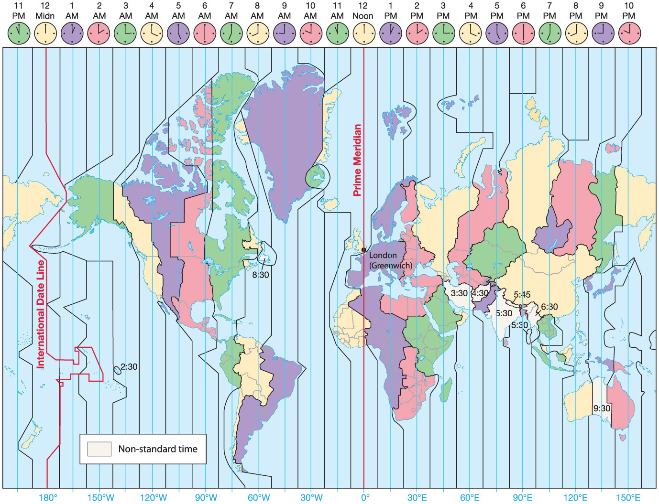


Notes:
Chapter 1, Figure 1.31 Labeled

Slide 17
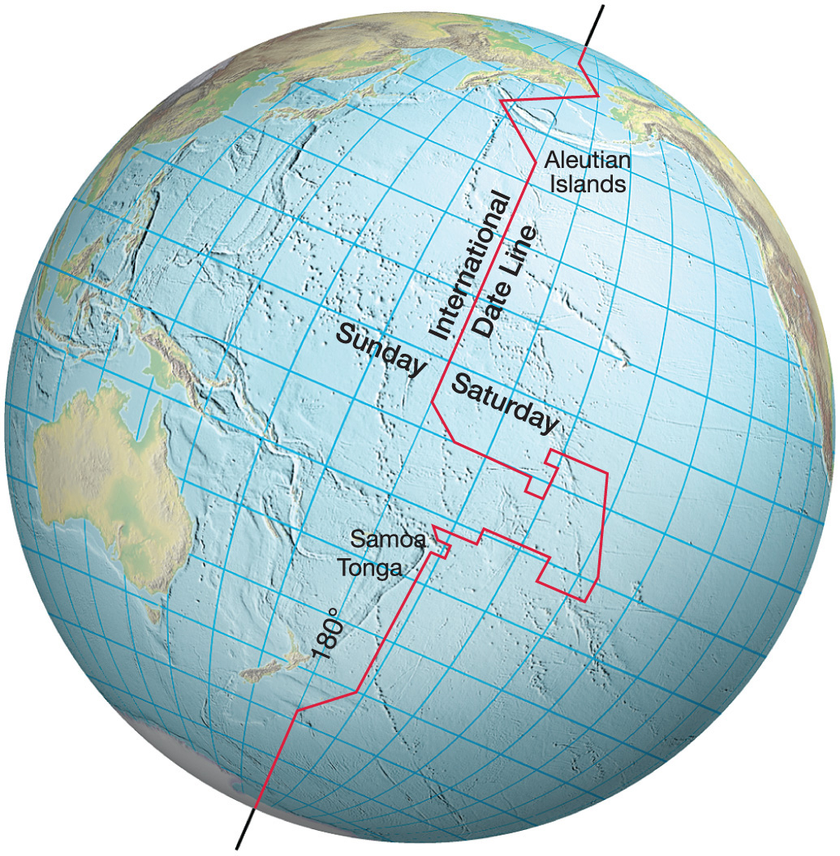


Notes:
Chapter 1, Figure 1.34 Labeled

